Slide 1

DEPARTMENT OF COMPUTER SCIENCE AND ENGINEERING
Automated Endometriosis Detection Using Histopathological Image Data with a Hybrid CNN RNN Model
Under the Guidance of
Ms.C.SUNEETHA M.Tech,
J.CHENCHU DHARANI[R190878]
R.KUSUMA[R190932]
N.REDDEPPA [R190879]

Slide 2
Abstract
Endometriosis, a condition that affects the female reproductive system, requires accurate and timely diagnosis for effective treatment. Histopathological image analysis is a crucial method in diagnosing various forms of uterine cancer, including endometrial cancer. This project presents an innovative approach for automated endometriosis detection using a hybrid deep learning model that integrates Convolutional Neural Networks (CNN) with Recurrent Neural Networks (RNN), specifically Long Short-Term Memory (LSTM) units. The goal is to enhance the classification accuracy of different endometrial tissue types based on histopathological images.
The dataset used in this study consists of histopathological images representing four main types of endometrial tissue: normal endometrium (NE), endometrial polyp (EP), endometrial hyperplasia (EH), and endometrioid adenocarcinoma (EA). To address the variability within these tissue types, the NE class is further subdivided into luteal, menstrual, and follicular phases of the menstrual cycle, while EH is divided into simple and complex hyperplasia. Such diversity in tissue morphology and the challenges of classifying them highlight the need for a hybrid CNN-RNN model to accurately extract both spatial and temporal features from the images.

Slide 3
Abstract
This dual approach allows for more comprehensive analysis, improving the model's ability to differentiate between subtle variations in tissue structures. To enhance generalization and prevent overfitting, the dataset was pre-processed and augmented, ensuring the model could effectively learn from a diverse set of image variations.
Experimental results demonstrate the superiority of the CNN-RNN hybrid model over traditional CNN-only approaches. The model achieves higher accuracy, sensitivity, and specificity across the classification tasks, confirming its potential for real-world clinical application. Cross-validation further substantiated the model's robustness and reliability in handling the complexity of histopathological image data
Tech Stack: Python, TensorFlow (with Keras), Convolutional Neural Networks (CNN), Recurrent Neural Networks (RNN) with LSTM, Jupyter Notebook.

Slide 4
Introduction
Endometriosis diagnosis significantly impacts women's reproductive health, with histopathological analysis being the gold standard. However, manual interpretation of tissue images is time-consuming and subjective, often delaying diagnoses. This project aims to address these challenges by developing an automated system using a hybrid CNN-RNN model to classify histopathological images more efficiently and accurately.
The dataset comprises 2308 images, split into training (2308), validation (493), and test (501) sets, organized by tissue types and subtypes. The classification task demands capturing both fine-grained spatial features and sequential dependencies, making the hybrid CNN-RNN architecture ideal.
The CNN component extracts spatial features, like edges, textures, and shapes, crucial for distinguishing tissue types. A fine-tuned pre-trained VGG16 architecture was employed for this purpose. The RNN, specifically an LSTM, processes the CNN output, capturing relationships across image regions for more context-aware predictions.
The model demonstrated significant improvements in accuracy, sensitivity, and specificity, effectively classifying different tissue types and subtypes. It has the potential to assist pathologists in diagnosing endometriosis more quickly and accurately, with applications in gynecological cancers.
However, the model's generalizability is limited by the dataset size. Future work will focus on expanding the dataset and optimizing the model for real-time clinical deployment.

Slide 5
Literature
Runyu Hong et al. (2021) introduced a Multi-Resolution CNN (Panoptes) model, which demonstrated its effectiveness by achieving an AUROC of up to 0.969 in predicting histological and molecular subtypes. This study highlighted the potential of deep learning for clinical applications, but it also faced challenges, particularly in the extensive data preprocessing required and the model's difficulty in classifying rarer molecular subtypes.
S. Visalaxi and T. Sudalai Muthu (2021) applied ResNet50 with transfer learning to laparoscopic images of endometriosis. Their model achieved a high classification accuracy of 92% during training and 90% during testing, with enhanced precision and recall for pathological regions. However, the study's reliance on a large labeled dataset and moderate AUC (0.78) indicated the need for improvements in model robustness.
Chen X (2020) employed the YOLOv3 detection model to analyze MRI images for predicting lesion locations and myometrial invasion in endometrial cancer. This approach achieved high specificity (87.5%) and a remarkable negative predictive value (96.3%). Nevertheless, the model's utility was constrained by its limitation to T2-weighted MRI, excluding other imaging modalities and thus reducing its generalizability for comprehensive diagnosis.

Slide 6
Literature
Sabrina Madad Zadeh (2021) utilized Mask R-CNN for semantic segmentation of uterine regions in laparoscopic images. The model performed exceptionally well, achieving a validation accuracy of 97%. Despite its success, it struggled to segment ovarian regions accurately, achieving only 24% accuracy due to insufficient annotated data, which limited its effectiveness for smaller datasets.
Dong HC (2020) proposed a CNN with U-Net architecture for MRI segmentation to detect early-stage endometrial cancer. This model improved lesion region segmentation but underperformed compared to expert radiologists. The study highlighted the need for additional training and validation using more diverse datasets to enhance the model's reliability and accuracy.

Slide 7

Motivation
Endometriosis, a complex and often misdiagnosed condition, significantly impacts women's reproductive health. Accurate and timely diagnosis is essential for effective treatment, but manual histopathological analysis is labor-intensive, subjective, and prone to delays. These challenges highlight the urgent need for automated, reliable, and efficient diagnostic tools in medical imaging.
Histopathological images provide a wealth of information, but their complexity requires sophisticated computational methods for accurate interpretation. Traditional machine learning models, while effective in simpler tasks, struggle to capture the intricate spatial and sequential patterns in histopathological data. The advent of deep learning, particularly Convolutional Neural Networks (CNNs) and Recurrent Neural Networks (RNNs), offers a promising solution by enabling automated feature extraction and pattern recognition.
The integration of data augmentation and robust preprocessing techniques ensures the model generalizes well despite the relatively small dataset. The project's ultimate goal is to reduce the burden on pathologists, accelerate diagnostic workflows, and provide a scalable solution for real-world clinical applications, paving the way for advancements in automated medical diagnostics.

Slide 8
Contribution
This project introduces a novel hybrid CNN-RNN architecture for automated detection of endometriosis, effectively combining spatial feature extraction and sequential pattern recognition. It classifies four primary tissue types (NE, EP, EH, EA) and subtypes, addressing the complexities of histopathological images. Advanced data augmentation techniques improve model generalization, while robust preprocessing ensures consistency in training. The model is evaluated using standard metrics (accuracy, precision, recall, F1-score) for comprehensive performance analysis. By demonstrating clinical relevance, the model supports faster, more accurate diagnoses, reducing the burden on pathologists. Additionally, the project outlines future enhancements, including attention mechanisms and dataset expansion, paving the way for advancements in gynecological diagnostics.
A hybrid CNN-RNN model for automated endometriosis detection, combining spatial feature extraction and sequential dependency learning to classify four primary tissue types (NE, EP, EH, EA) and subtypes. Advanced data augmentation and preprocessing enhance generalization and robustness. The model achieves promising results, supporting faster, more accurate diagnoses while reducing pathologists' workload. Evaluated with metrics like accuracy and F1-score, it demonstrates clinical applicability. Future directions include incorporating attention mechanisms and expanding datasets, paving the way for improved gynecological diagnostics.

Slide 9
Module 1: Data collection and Data augmentation
In any machine learning project, especially one involving image classification, the quality and quantity of the data play a crucial role in determining the success of the model. For deep learning models such as Convolutional Neural Networks (CNNs) and Recurrent Neural Networks (RNNs), large and diverse datasets are required to enable the model to learn complex patterns and generalize well. Data collection and augmentation, therefore, are critical steps in the development of a robust machine learning pipeline.
Data Collection for Histopathological Images:
Data collection for this project involved acquiring a comprehensive dataset of histopathological images, specifically focused on detecting endometriosis from tissue samples. Histopathological images are obtained through the process of biopsies or surgical samples, where tissue sections are stained, mounted on slides, and examined under a microscope. For this project, the images were collected from various sources, ensuring a broad representation of the different tissue types and subtypes associated with endometriosis.

Slide 10
Module 1: Data collection and Data augmentation
Dataset Overview : The dataset for this project consists of 3302 images, with each image labelled according to its respective class. The dataset includes four primary tissue types:
• Normal Endometrium (NE)
• Endometrial Polyp (EP)
• Endometrial Hyperplasia (EH)
• Endometrioid Adenocarcinoma (EA) Furthermore,
The NE class is subdivided into three subtypes:
• Luteal Phase
• Menstrual Phase
• Follicular Phase 8
The EH class is subdivided into two categories:
• Simple Hyperplasia
• Complex Hyperplasia

Slide 11
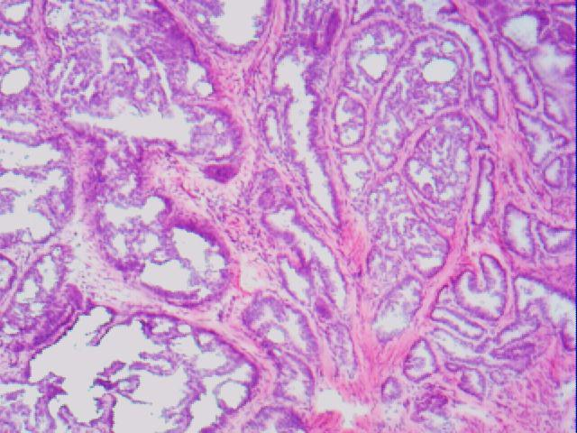
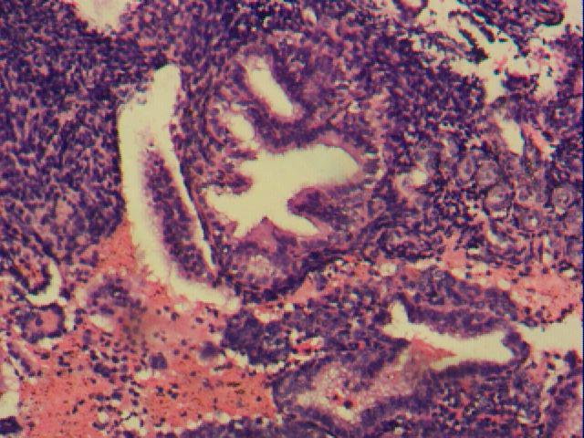
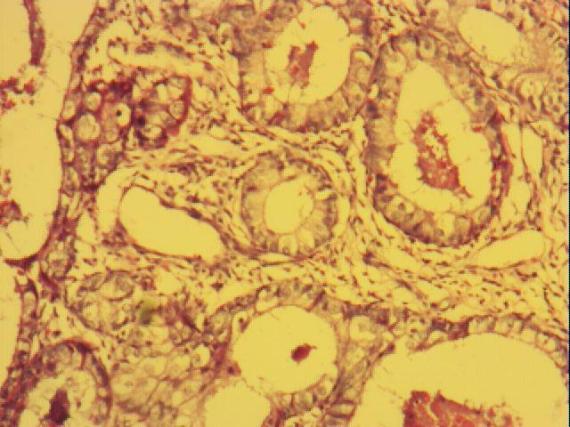
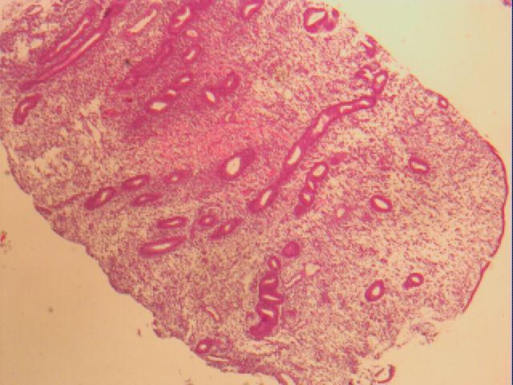
Module 1: Data collection and Data augmentation
Figure 1.1: EA
Figure 1.2: NE
Figure 1.3 EH
Figure 1.4 EP

Slide 12
Module 1: Data collection and Data augmentation
Data Sources: For this project, the images were sourced from publicly available medical datasets and collaboration with hospitals or medical research centers. Several databases, such as The Cancer Imaging Archive (TCIA) and other research publications on endometriosis, provided annotated images of endometrial tissues that were useful for training the deep learning models.
Preprocessing of Data: Data preprocessing is a crucial step to ensure that the data is in the right format and optimized for the model. For histopathological images, this involves a series of transformations that standardize the images and make them suitable for feeding into the deep learning model.
Data Splitting: The dataset was split into three main sets:
• Training Set: 2308 images used for training the model.
• Validation Set: 493 images used to validate the model during training.
• Test Set: 501 images used for evaluating the final performance of the model.
This division ensures that the model is trained on a set of images, validated to avoid overfitting, and tested on unseen data to estimate its generalization capabilities.

Slide 13
Module 1: Data collection and Data augmentation
Data Augmentation :Techniques Data augmentation plays a vital role in improving the performance of deep learning models, especially when dealing with limited data. By artificially increasing the size of the dataset, data augmentation helps the model become more robust and able to generalize better to unseen images.
Types of Augmentation Applied For the histopathological images in this project, several augmentation techniques were employed, including:
• Rotation: Random rotation of images helps the model recognize tissue patterns from different orientations, mimicking the natural variability found in real-world medical imaging.
• Flipping: Horizontal and vertical flips simulate variations in how tissue images might appear in different orientations. This technique helps the model become invariant to the direction of tissue samples.
• Zooming: Random zooms help the model focus on different regions of the tissue samples, providing a broader view of features and improving the robustness of feature extraction.
• Shifting: Random shifts horizontally and vertically ensure that the model is not biased by the location of the tissue within the image.
• Shearing: This technique alters the shape of the image to simulate slight distortions, which can be expected in actual slide preparation

Slide 14
Module 2: Defining the Model and Training
Once the data has been prepared and augmented, the next crucial step in any machine learning pipeline is to define and train the model. For the automated detection of endometriosis using histopathological images, we have chosen a hybrid deep learning model that combines Convolutional Neural Networks (CNNs) and Recurrent Neural Networks (RNNs). This hybrid architecture is designed to effectively handle spatial and sequential dependencies in the image data, which is essential for accurately classifying the different tissue types and subtypes associated with endometriosis.
Overview of the Model Architecture: The model used in this project is a hybrid architecture that combines the strengths of CNNs for spatial feature extraction and RNNs (specifically Long Short-Term Memory or LSTM) for sequential pattern recognition. The CNN component is responsible for learning the spatial features in the histopathological images, such as textures, edges, and patterns that are characteristic of different tissue types. The RNN component, on the other hand, processes the temporal dependencies in the sequence of features extracted by the CNN, allowing the model to learn how these features evolve across different stages and classes of endometriosis.
In the model, the CNN architecture consists of several convolutional blocks,
Where each block consists of:
• Convolutional Layer: Filters applied to extract features.
• Activation Function (ReLU): Introduces non-linearity and ensures the model can learn complex features.
• Max Pooling: Reduces the spatial dimensions of the image while retaining important features.

Slide 15
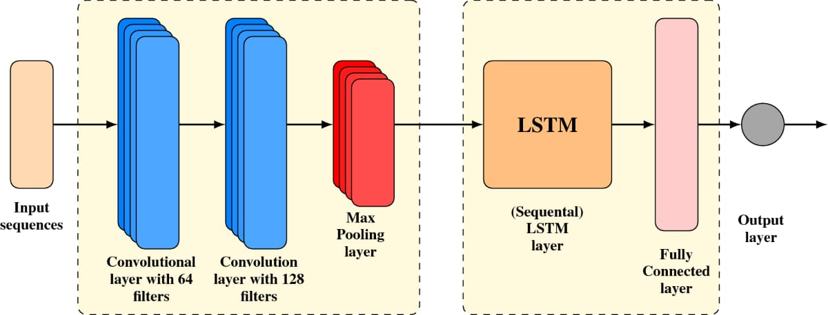
Module 2: Defining the Model and Training
Model Integration:
CNN + RNN Hybrid Model The hybrid CNN-RNN model combines the best of both worlds: the CNN handles the spatial feature extraction, while the RNN captures temporal relationships. This hybrid model is particularly effective for the classification of histopathological images, where the spatial structure of tissue types and the sequential progression of tissue abnormalities must be understood. By combining CNN and RNN, the model benefits from improved feature extraction and pattern recognition, ultimately leading to better classification accuracy.
Figure 2.1: Hybrid Model Architecture

Slide 16
Module 2: Defining the Model and Training
The complete architecture consists of:
• Convolutional Layers (CNN): Extracts local features.
• Pooling Layers: Reduces the dimensionality.
• Flattening Layer: Converts the 2D feature maps into 1D vectors.
• LSTM Layers (RNN): Processes the extracted features in sequence.
• Dense Layer: Final fully connected layer for classification.
• SoftMax Activation: Outputs class probabilities for each tissue type.
Model Implementation
Defining the Model in Keras:
The model was implemented using the Keras deep learning framework with TensorFlow as the backend. Keras provides a high-level interface to define complex models in a simple and user-friendly way. Below is a sample implementation of the CNN-RNN hybrid model for endometriosis detection.

Slide 17
Module 2: Defining the Model and Training
Model Training
Training Parameters: The training of the model is a crucial process that involves adjusting various parameters to ensure the model converges to an optimal solution.
The following training parameters were used:
• Epochs: 50 epochs were selected to allow the model sufficient time to learn from the data.
• Batch Size: A batch size of 32 was used to strike a balance between computation efficiency and convergence.
• Optimizer: Adam optimizer was chosen due to its adaptive learning rate and good performance on image data.
• Loss Function: Categorical cross-entropy was selected since this is a multi-class classification problem.
• Metrics: Accuracy was used as the performance metric.
Model Training Process
The model was trained on the augmented training dataset, which included various transformations of the original images to improve generalization. During training, the model adjusted its weights based on the gradient of the loss function with respect to the parameters, using backpropagation.

Slide 18
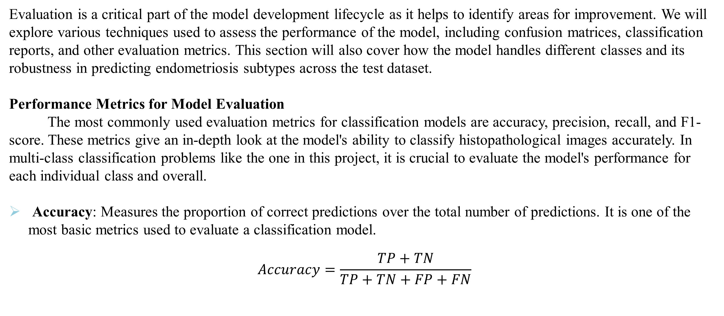
Module 3: Model Evaluation and Integration
Evaluation is a critical part of the model development lifecycle as it helps to identify areas for improvement. We will explore various techniques used to assess the performance of the model, including confusion matrices, classification reports, and other evaluation metrics. This section will also cover how the model handles different classes and its robustness in predicting endometriosis subtypes across the test dataset.
Performance Metrics for Model Evaluation
The most commonly used evaluation metrics for classification models are accuracy, precision, recall, and F1-score. These metrics give an in-depth look at the model's ability to classify histopathological images accurately. In multi-class classification problems like the one in this project, it is crucial to evaluate the model's performance for each individual class and overall.
Accuracy: Measures the proportion of correct predictions over the total number of predictions. It is one of the most basic metrics used to evaluate a classification model.
$$Accuracy=\frac{TP+TN}{TP+TN+FP+FN}$$

Slide 19
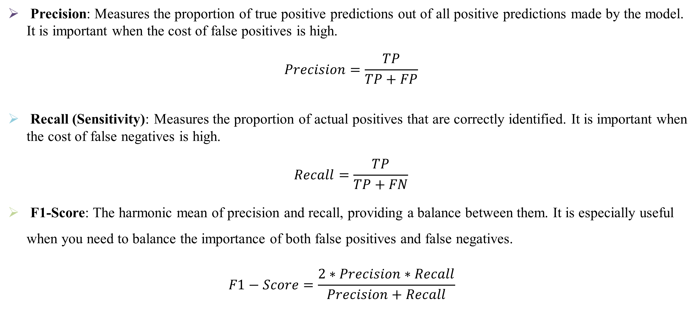
Module 3: Model Evaluation and Integration
Precision: Measures the proportion of true positive predictions out of all positive predictions made by the model. It is important when the cost of false positives is high.
$$Precision=\frac{TP}{TP+FP}$$
Recall (Sensitivity): Measures the proportion of actual positives that are correctly identified. It is important when the cost of false negatives is high.
$$Recall=\frac{TP}{TP+FN}$$
F1-Score: The harmonic mean of precision and recall, providing a balance between them. It is especially useful when you need to balance the importance of both false positives and false negatives.
$$F1−Score=\frac{2∗Precision∗Recall}{Precision+Recall}$$

Slide 20
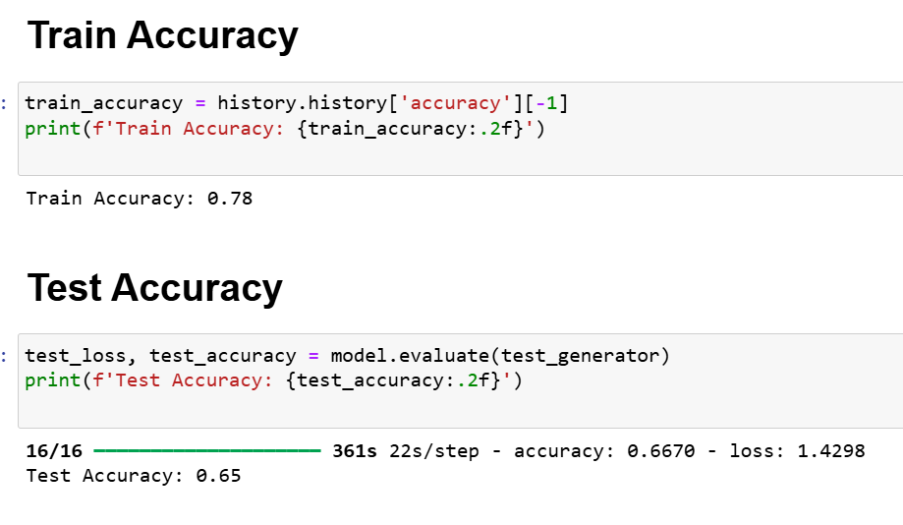
Module 3: Model Evaluation and Integration

Slide 21
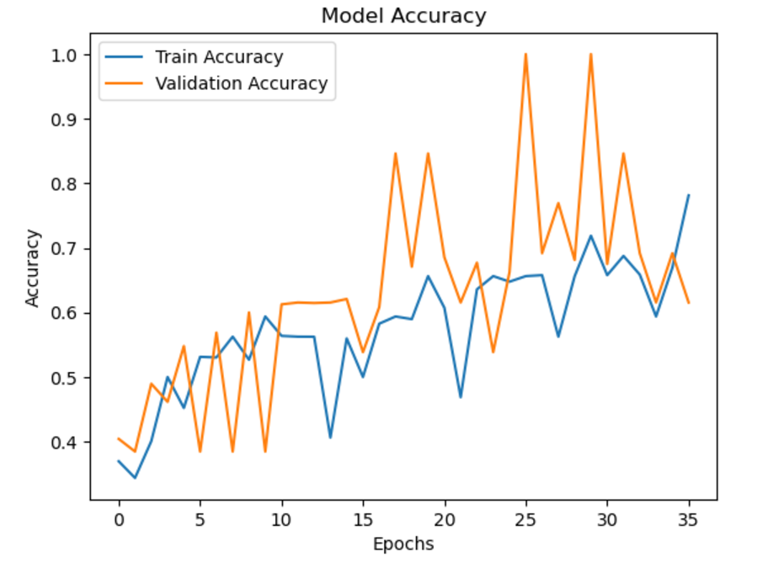
Module 3: Model Evaluation and Integration
Graph 3.1: Model Accuracy

Slide 22
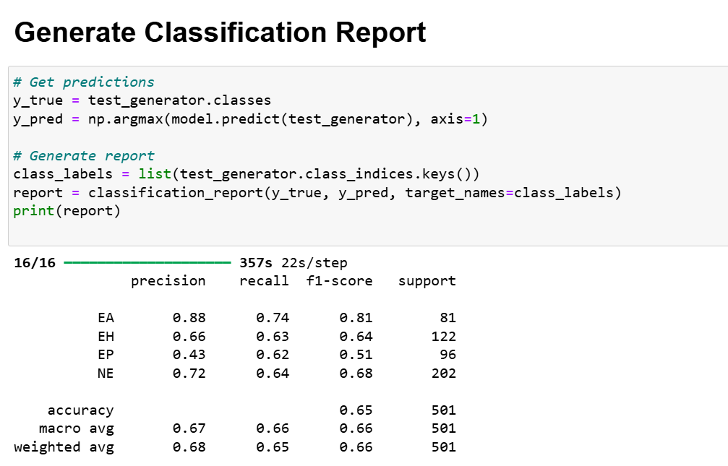
Module 3: Model Evaluation and Integration
Classification Report
The classification report is a summary of the precision, recall, F1-score, and support for each class. It provides a comprehensive overview of how well the model performs across all classes in terms of both accuracy and class imbalance. In the case of multi-class classification, the classification report will include these metrics for each of the four main classes as well as for the subtypes of normal endometrium (luteal, menstrual, follicular) and endometrial hyperplasia (simple, complex).

Slide 23
Module 3: Model Evaluation and Integration
Confusion Matrix
The confusion matrix is a powerful tool for visualizing the performance of a classification model. It shows the number of correct and incorrect predictions made by the model across all classes. The matrix is particularly useful in identifying patterns in the misclassifications, which can help in understanding which classes are being confused with others.
True Positive (TP): Instances that were correctly classified as positive.
True Negative (TN): Instances that were correctly classified as negative.
False Positive (FP): Instances that were incorrectly classified as positive.
False Negative (FN): Instances that were incorrectly classified as negative.
A detailed analysis of the confusion matrix will help to identify specific areas where the model is performing well or where misclassifications are occurring.

Slide 24
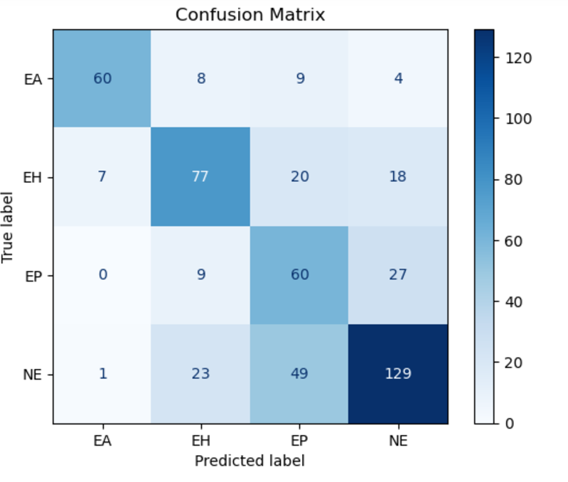
Module 3: Model Evaluation and Integration
Confusion Matrix showing the classification results for the four main classes (NE, EP, EH, EA) and subtypes.
Graph 3.2: Confusion Matrix

Slide 25

Module 3: Model Evaluation and Integration
Integration Using Flask
The integration phase involved creating a user-friendly web application that allows users to upload histopathological images and receive real-time predictions from the trained model. Flask was chosen for its simplicity and flexibility, making it ideal for deploying machine learning models as web applications.
Flask Setup:
Flask was installed and configured as the backend framework for the application.
Required dependencies such as TensorFlow, Flask, and OpenCV were installed for model inference and image handling.
2. Building the User Interface:
A simple HTML/CSS-based frontend was developed, consisting of:
▪ A file upload form to allow users to upload histopathological images.
▪ A submit button to send the uploaded image to the backend for processing.
▪ A result section to display the predicted class and confidence score.
Figure 3.1: User Interface

Slide 26
Module 3: Model Evaluation and Integration
3. Backend Functionality:
o The model was loaded into memory using TensorFlow's load_model() function.
o Uploaded images were processed to match the input dimensions required by the CNN-RNN model.
o Predictions were generated, and the class label along with the confidence score was returned to the user.
4. Workflow:
o The user uploads an image via the web interface.
o The backend processes the image, runs it through the hybrid CNN-RNN model, and sends the result back to the frontend.
o The frontend displays the classification result along with confidence scores.

Slide 27
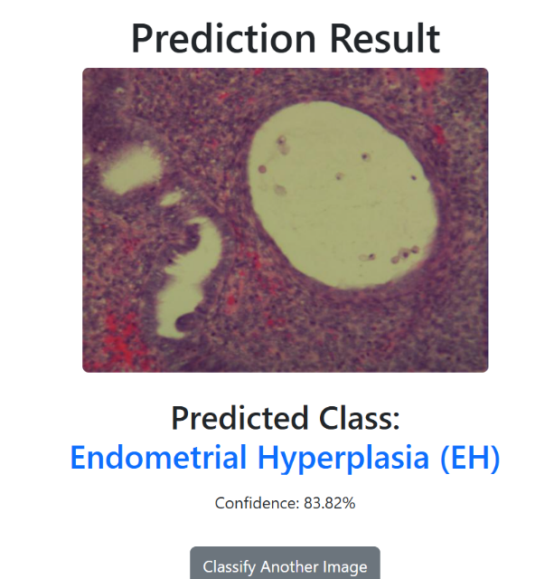
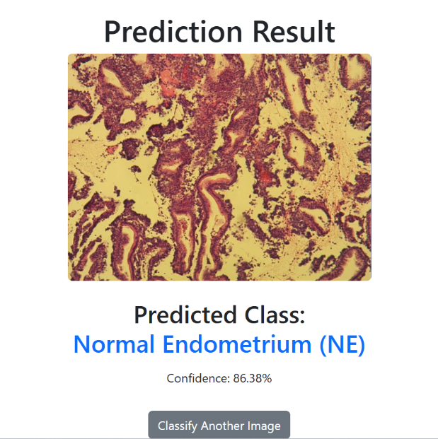
Module 3: Model Evaluation and Integration
The system successfully classified the uploaded images, predicting one as Endometrial Hyperplasia (EH) with 83.82% confidence and another as Normal Endometrium (NE) with 86.38% confidence. These results demonstrate the model’s effectiveness in distinguishing pathological and normal tissues using its CNN+RNN hybrid architecture. Such predictions validate the model’s potential to support diagnostic processes with reliable and precise classifications.
Figure 3.2:Predicted Result

Slide 28
Results and Discussion
Results: The evaluation of the hybrid CNN-RNN model was conducted on a test dataset consisting of 501 images, classified into four categories: EA, EH, EP, and NE.
The following sections provide a detailed analysis of the model's performance based on various metrics and observations.
• Training Accuracy: The model achieved a training accuracy of 78%, indicating a good ability to fit the training data.
• Test Accuracy: A test accuracy of 65% was observed, suggesting that the model is moderately generalizing to unseen data but still leaves room for improvement.
class | precision | Recall | F1 Score | Support
EA | 0.88 | 0.74 | 0.81 | 81
EH | 0.66 | 0.63 | 0.64 | 122
EP | 0.43 | 0.62 | 0.51 | 96
NE | 0.72 | 0.64 | 0.68 | 202
Table summarizes the precision, recall, and F1-scores for each class. These metrics provide insights into the model’s ability to classify different tissue types accurately.

Slide 29
Results and Discussion
EA (Endometrioid Adenocarcinoma): Achieved the highest precision (0.88) and F1-score (0.81), reflecting the model's ability to detect this class with reasonable accuracy. However, the recall (0.74) indicates that some true positives were missed.
EH (Endometrial Hyperplasia): Moderate precision (0.66) and recall (0.63) suggest that the model struggles slightly to distinguish this class from others.
EP (Endometrial Polyp): The lowest precision (0.43) highlights significant challenges in accurately identifying this class. A recall of 0.62 indicates better sensitivity but still shows room for improvement. 31
NE (Normal Endometrium): A relatively balanced performance with precision (0.72) and recall (0.64), reflecting adequate identification of normal tissue.
Macro Average: The macro averages of precision (0.67), recall (0.66), and F1-score (0.66) indicate that the model's performance is consistent across classes, but not exceptional.
Weighted Average: A weighted average F1-score of 0.66 shows that the model favors classes with higher support, such as NE and EH.
The confusion matrix (Table 1) reveals the specific misclassifications. Common Misclassifications: Instances of EP are often misclassified as EH or NE due to overlapping features. Similarly, EH is occasionally confused with EA, possibly due to similar morphological characteristics..

Slide 30
Discussions
Discussions The results of the hybrid CNN-RNN model highlight its ability to handle the complexity of histopathological image classification, achieving a training accuracy of 78% and a test accuracy of 65%. The model demonstrates strong performance for certain classes, such as EA and NE, where precision and F1-scores are relatively high. This underscores the efficacy of the CNN in capturing intricate spatial features and the RNN in identifying temporal dependencies. However, the gap between training and test accuracies suggests overfitting, which indicates the need for more robust regularization techniques or enhanced dataset diversity.
Despite these challenges, the hybrid approach provides a solid foundation for understanding spatial and sequential patterns in histopathological data. The results not only validate the potential of combining CNN and RNN architectures but also highlight avenues for future optimization. Improved training strategies and richer datasets could further enhance the model's applicability to real-world diagnostic scenarios.

Slide 31
Conclusion and Future Enhancement
Conclusion: This project successfully implemented a hybrid CNN-RNN model to classify histopathological images into four types of endometrial tissues: EA, EH, EP, and NE. The integration of CNNs for spatial feature extraction and RNNs (specifically LSTMs) for sequential learning demonstrated the potential to handle the complex patterns in histopathological data effectively. The model achieved a training accuracy of 78% and a test accuracy of 65%, highlighting its capability to identify tissue types despite the inherent challenges posed by overlapping features and class imbalances. This hybrid architecture serves as a significant step toward automating endometriosis diagnosis, reducing the reliance on manual interpretations, and accelerating clinical decision-making.
While the results are promising, there is room for improvement. Addressing class specific issues, particularly the lower performance in EP and EH classifications, requires fine tuning the model and exploring additional strategies. For instance, implementing attention mechanisms could help focus on critical features, while experimenting with ensemble learning techniques might enhance overall performance. Increasing dataset diversity by incorporating images from varied sources and using advanced augmentation techniques could further improve the model's robustness.

Slide 32
Conclusion and Future Enhancement
Future Enhancement :
Future enhancements include the development of a real-time clinical application by optimizing the model for deployment in healthcare environments. Leveraging frameworks like TensorFlow Lite for model compression and ensuring compatibility with edge devices will enable seamless integration into diagnostic workflows. Additionally, expanding the scope of the dataset to include other gynecological conditions could make the system more comprehensive. These advancements have the potential to transform the hybrid CNN-RNN model into a valuable tool for pathologists, providing reliable, fast, and accurate support for endometriosis and related diagnoses.

Slide 33
References
[1] S. Kumar and M. Singh, "Breast Cancer Detection Based on Feature Selection Using Enhanced Grey Wolf Optimizer and Support Vector Machine Algorithms", Vietnam Journal of Computer Science, vol. 08, no. 02, pp. 177-197, 2020.
[2] H. Chen, Z. Zhang, W. Yin, C. Zhao, F. Wang and Y. Li, "A study on depth classification of defects by machine learning based on hyper-parameter search", Measurement, vol. 189, p. 110660, 2022.,https://doi.org/10.1016/j.measurement.2021.110660.
[3] K. Skorupskaite and H. Bhandari, "Endometriosis and fertility", Obstetrics, Gynaecology & Reproductive Medicine, vol. 31, no. 5, pp. 131-136, 2021., https://doi.org/10.1016/j.ogrm.2021.03.003.
[4] B. Shi et al., "Early Recognition and Discrimination of COVID-19 Severity Using Slime Mould Support Vector Machine for Medical Decision-Making," in IEEE Access, vol. 9, pp. 121996-122015, 2021.

Slide 34
Thank you

